Slide 1
Digital & Analog Clock Display using FPGA
Group 4

Slide 2
Quad- Seven Segment Code
Quad- Seven Segment LEDs
Switches & Buttons
Sec (units)
Sec (tens)
Time-Keeping
Counters
Min (units)
Digital Display
Min (tens)
Hr (units)
PicoBlaze
+
Line-Draw
Algorithm
Hr (tens)
VGA
7 counters:
1 gives a pulse every second (1Hz)
The rest of the counters give the time information
Analog Display

Slide 3
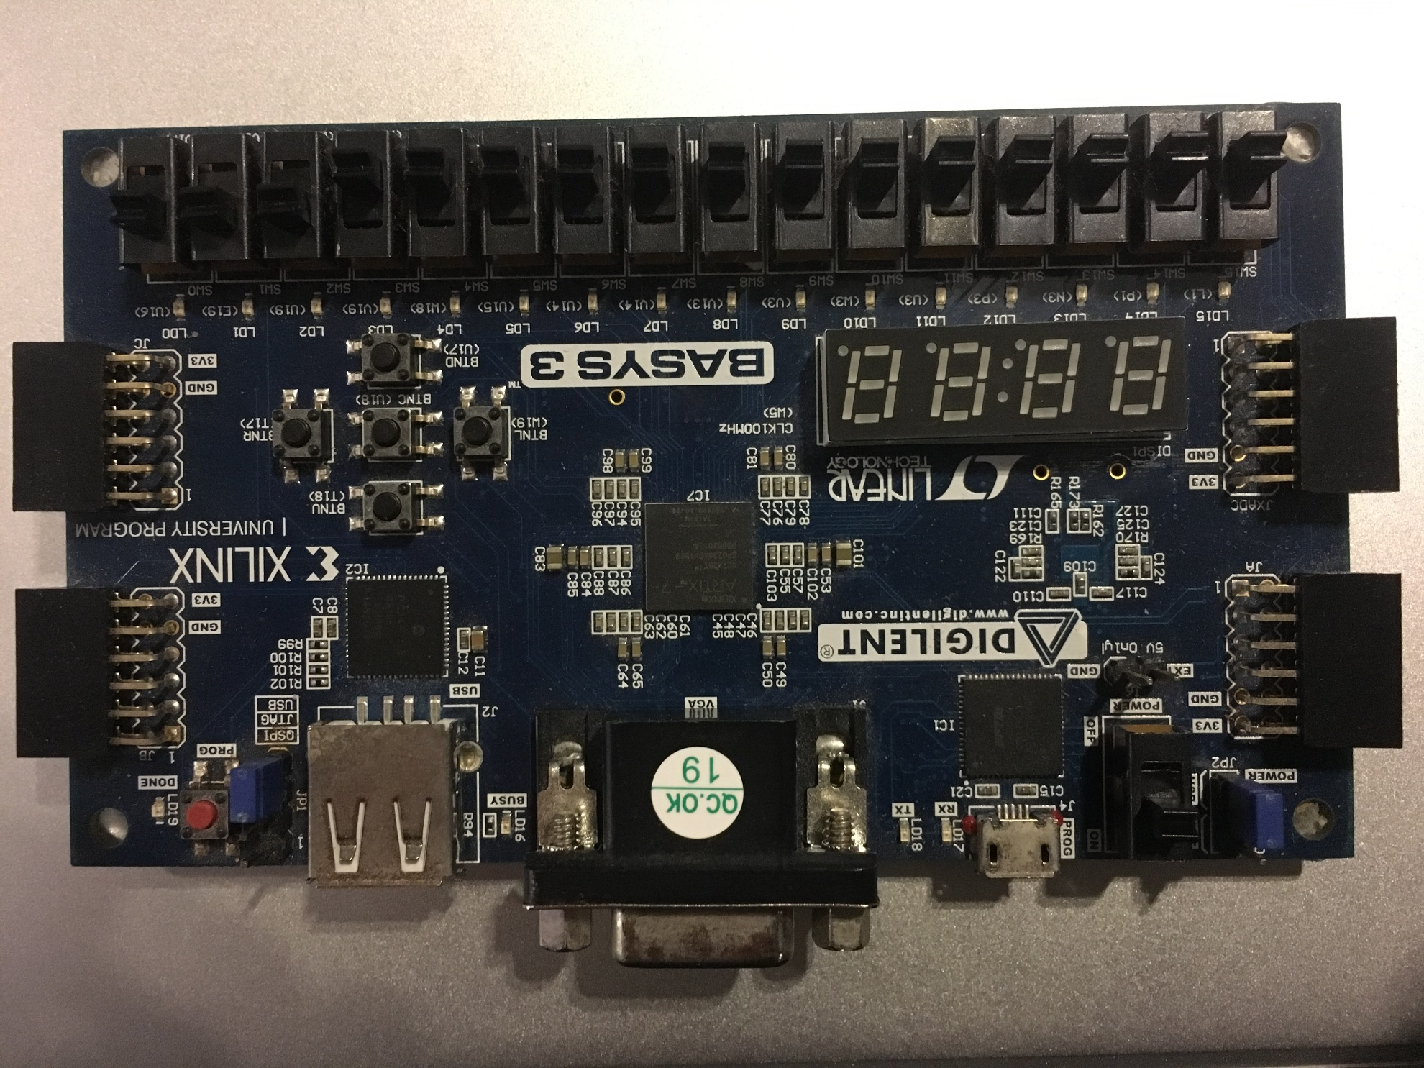
VGA Display
Insert value to:
Min (Units)
Min (Tens)
Hr (Units)
Hr (Tens)
Displays: Min & Sec Or Hr & Min
Switch VGA Display between:
Analog Display ↔ Digital Display
Switch Display between:
Min & Sec ↔ Hr & Min
Value to be written to the
Time registers

Slide 4
VGA Display
PicoBlaze
Compare values
Digital Display
Seconds,
Minutes,
Hours
Switch
Analog Display
The idea is:
First, the time information are stored in 6 registers in the picoblaze.
Then, the “Sec-Units” is compared with all numbers 0-9.
According to its value, the program jumps to a certain set of code lines that draw (using the drawing algorithm code) that certain number
When that is done, the same will be done to “Sec-Tens”, … & so on.
The whole frame is drawn every 1/60th of a second. There is an interrupt that comes to the picoblaze from the outside (draw line algorithm block) every 1/60th of a second.
The frame is erased before drawing every 1/60th of a second.

Slide 5
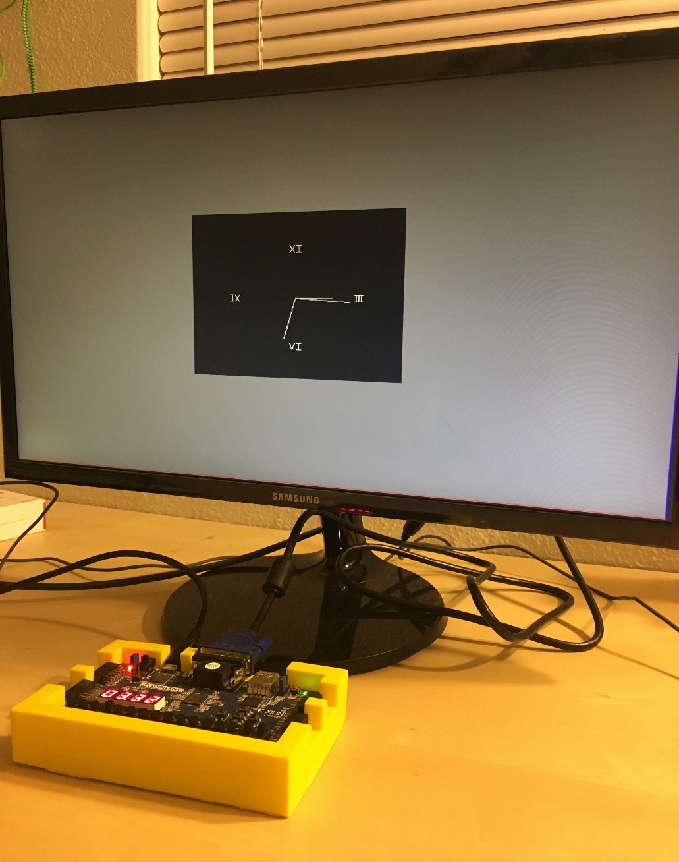
Analog Display

Slide 6
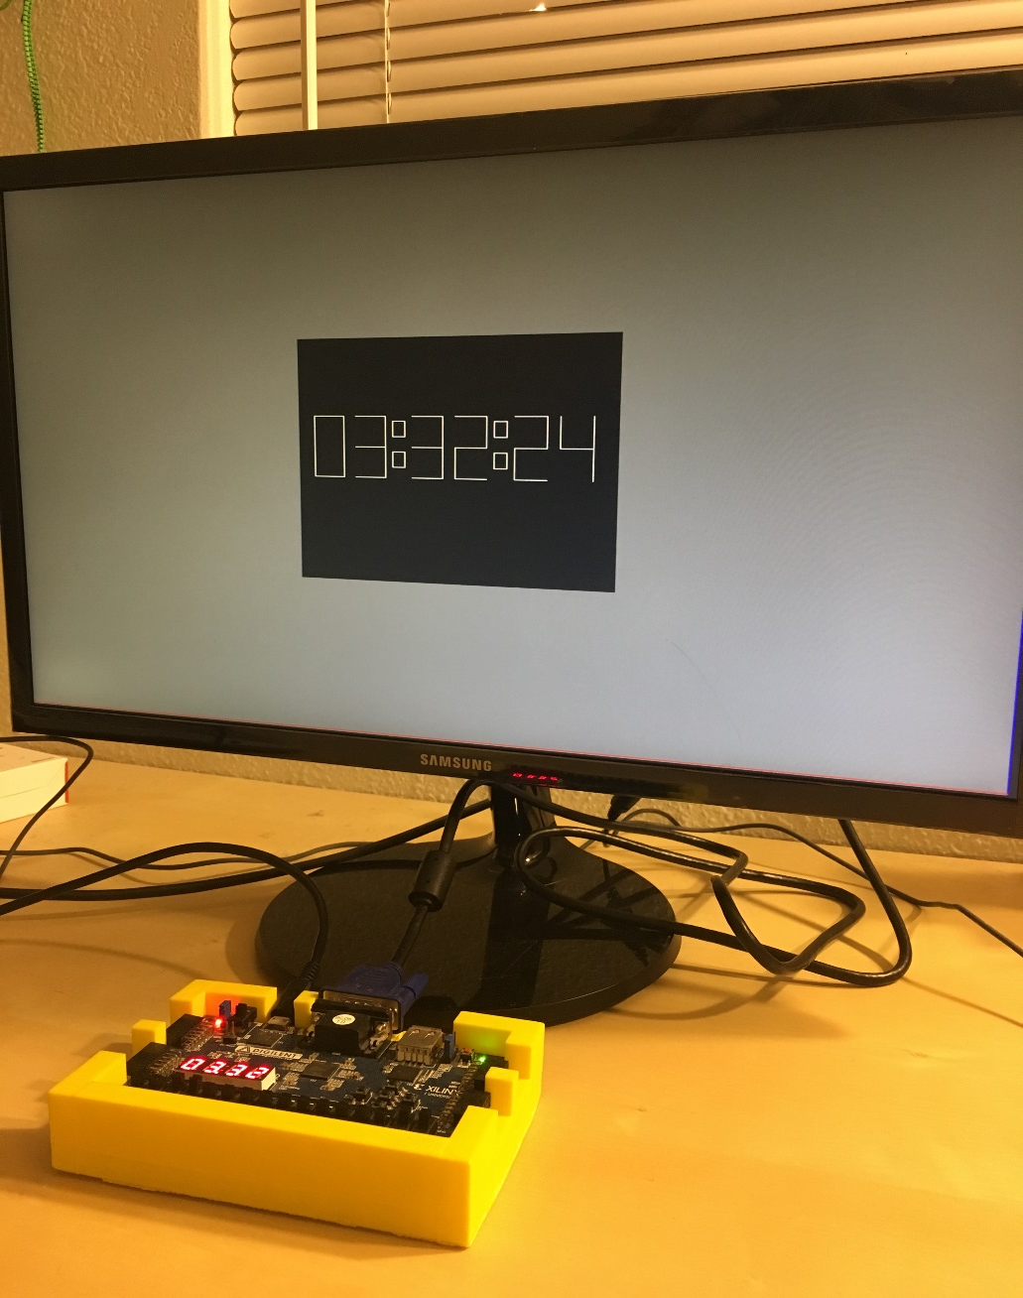
Digital Display

Slide 7
Links to the material
http://www.eric.crabill.org/
https://drive.google.com/drive/folders/1JvVr4amOXQE0dqAIHVlUzsUnugPQMXc1?usp=sharing
Project:
https://drive.google.com/drive/folders/1QCiNa7iVuNNrkJ16X37NimUBDMLxXcll?usp=sharing

